Slide 1
Deployment and Operations for Software Engineers 2 nd Ed
Chapter 2 - Virtualization

Slide 2
Outline
Virtual machines
Virtual machine images
Containers
Container repositories
Serverless architecture

Slide 3
What is a Virtual Machine?
A Virtual Machine (VM) is a software construct that exposes the resources of CPU, memory, disk, and network connection to loaded software making it appear to the loaded software that it is executing on a physical computer.
A VM runs under the control of a specialized operating system called a hypervisor.

Slide 4
Type 1 Hypervisor
Host computer
•
•
The hypervisor is the operating system for virtual machines
A type 1 hypervisor runs on bare metal.
Apps
Apps
Apps
OS1
OS2
OS3
VM1
VM2
VM3
Hypervisor

Slide 5
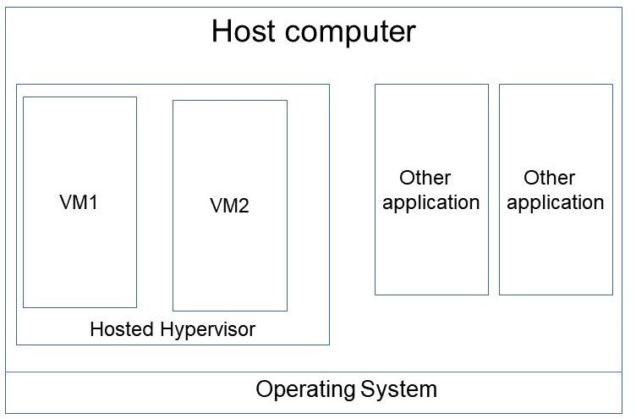
Type 2 Hypervisor
A type 2 hypervisor runs on top of your laptop’s operating system.
From the perspective of the laptop’s OS, it is an application.

Slide 6
VM resources
From the perspective of software executing inside a VM, it is the same as software executing on a bare metal computer.
A VM has the same resources as a physical computer.
CPU
Memory
Disk
Network connection

Slide 7
Discussion questions
How are the actions of one VM kept separate from the actions of another VM on the same host?
(hint: think one resource at a time)
How does a VM write to a disk?
How does a VM write to the network?
How is a VM created?
How are VMs booted?

Slide 8
Outline
Virtual machines
Virtual machine images
Containers
Container repositories
Serverless architecture

Slide 9
VM Image
A VM image is a set of bits on a disk (or from over a network) that contains all of the software, directories, and data from its created VM
An image is created by
building a VM or physical computer with all of the desired software.
Writing the contents of memory to a disk file (or sending it over a network)
A VM is created by reading an image.

Slide 10
Creating an image and using it to create another VM
VM used to create image
VM with image from original VM
VM image
Write all of
memory
Read all of memory

Slide 11
Image across network
Suppose image is 8 Gb(yte).
Reasonable network speed is 1 Gb(it)/sec (rated)
8 bits per byte
Moving image, in theory, will take 64 seconds.
In practice a 1Gb(it) network speed is .35 Gb(it)/sec
Transferring image will take ~3 minutes.
VM still must be booted to execute in new location.

Slide 12
Discussion questions
Can a VM image created on AWS be moved to Google Cloud?

Slide 13
Outline
Virtual machines
Virtual machine images
Containers
Container repositories
Serverless architecture

Slide 14
Container is light weight virtualization mechanism
Containers are a mechanism to maintain the advantages of virtualization—isolation of its actions from other containers—while reducing image transfer time and startup time.
A container is an executable image that packages a service and its dependent libraries. It runs under the control of a container engine.

Slide 15
Container Isolation
Containers are isolated from each other in terms of
address space
Disk usage
Processor usage
Network usage (with some exceptions).

Slide 16
Executing container
Containers execute on top of a container run time engine
This, in turn, executes on top of an operating system
Means containers share a single operating system
App1
App2
App3
Container run time engine
Host Operating System
Bare metal or Virtual Machine

Slide 17
Dependencies
A container not only includes code for a service but all of the dependencies of that code.
This means that containers are self contained – they can run in any environment which has a run time engine.

Slide 18
Container layers
Packaged as layers within a single container
Containers can be segmented into layers.
E.g. consider the LAMP stack – Linux, Apache, MySQL, PhP
Each item can be made a separate layer
PhP
MySQL
Apache
Container runtime
Linux

Slide 19
Virtue of using layers
Suppose only the top layer has changed. Then when moving the container, only the top layer must be moved. E.g., a new version of PhP in our example.
This makes moving a container much lighter weight than moving a VM. On the order of milliseconds rather than minutes.

Slide 20
Comparing VMs and containers
VMs virtualize hardware
Containers virtualize operating systems
VMs take minutes to transfer over a network
Containers can be transferred in milliseconds—depending on the mechanisms used
VMs are monitored, started and stopped by the hypervisor
Containers are monitored, started and stopped by the run time engine.

Slide 21
Discussion questions
How are the actions of one container kept separate from the actions of another container on the same host? On the same runtime engine?
How does a container write to a disk?
How does a container write to the network?
How is a container created?
How are container placed into execution?
How does the container management system know that only the top layer has been changed?

Slide 22
Outline
Virtual machines
Virtual machine images
Containers
Container repositories
Serverless architecture

Slide 23
Container repositories
Container images are typically stored in repositories
Similar to version control systems
Accessible with permissions
Push/pull interface
Images can be tagged with version numbers

Slide 24
Docker Hub
Docker Hub is a publicly available repository.
Since it is open source, It is also used for private container repositories
It is the most widely used container repository
Private repositories can be access controlled

Slide 25
Integrating with development workflow
Multiple team members may wish to share images
Images can be in production, under development or under test
Private container repository allows images to be stored and shared.
Any image can be “pulled” to any host
Tagging as “latest” allows updates to be propagated. Pull <image name>:latest gets the last image checked into repository with that name.

Slide 26
Discussion question
Are there container repositories other than Docker Hub? Why would you choose one over the other?

Slide 27
Outline
Virtual machines
Virtual machine images
Containers
Container repositories
Serverless architecture

Slide 28
Serverless architecture example
A simple example using PhP.
PhP is an interpreted language.
A file containing your program is fed to the interpreter to be executed.
Cloud provider has pool of PhP servers.
You tell one of the pool the location of the file with your program.
Your program is executed immediately.

Slide 29
Serverless definition
A serverless architecture consists of
A pool of servers with container run time engines
A stateless container with no dependencies on your other code
Since the container has no external dependencies, it can be executed directly by any run time engine.

Slide 30
Serverless activation
Container is deployed and activated when a message arrives for it.
Loads in milliseconds depending on cloud provider’s caching strategy.
For AWS, only one request per instance.

Slide 31
More complicated example
Suppose you wish to send an email welcome message to a new subscriber.
Your container
Consists of code to prepare and send the email.
Parameters are email address and subscriber’s name.
Container is stateless. Necessary information comes from request parameters.
Your full system sends request to the welcome message container with request parameters.
This triggers the cloud provider to load and activate it.
Email message is sent.

Slide 32
Discussion questions
How does the cloud provider know that a container is intended to be serverless?
What are restrictions on serverless container other than it must be stateless?

Slide 33
END OF CHAPTER 2

